Slide 1
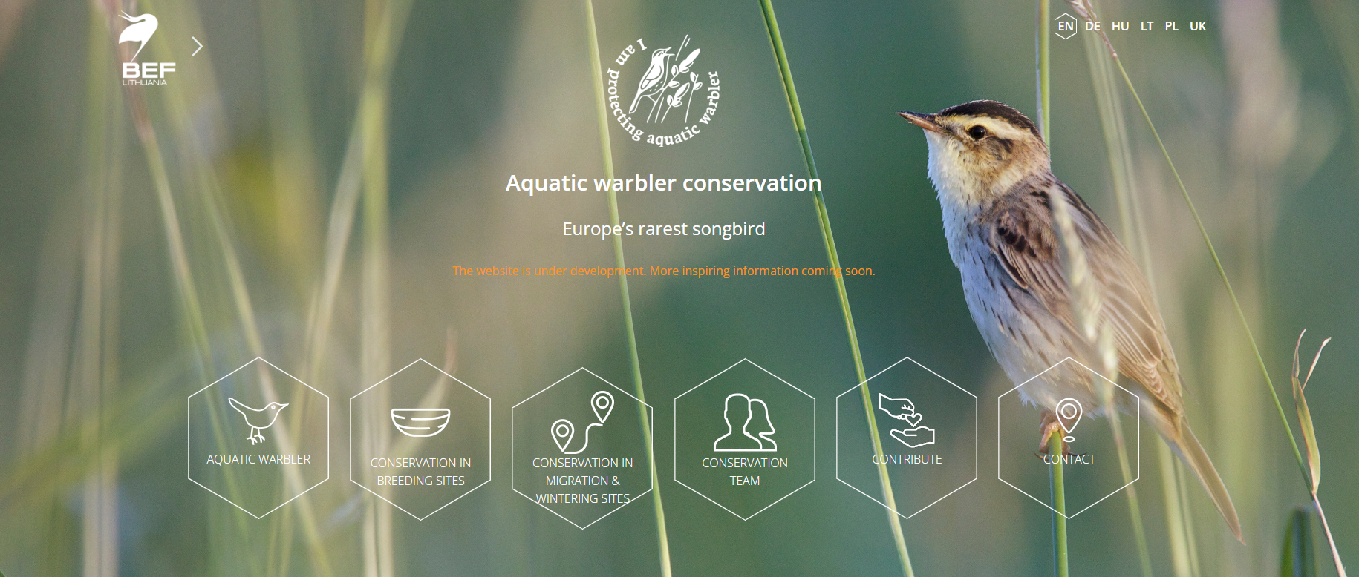
Reintroduction of Aquatic Warblers to Germany

Slide 2
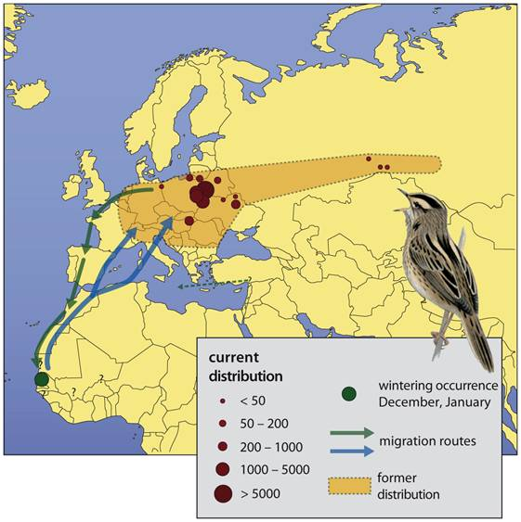
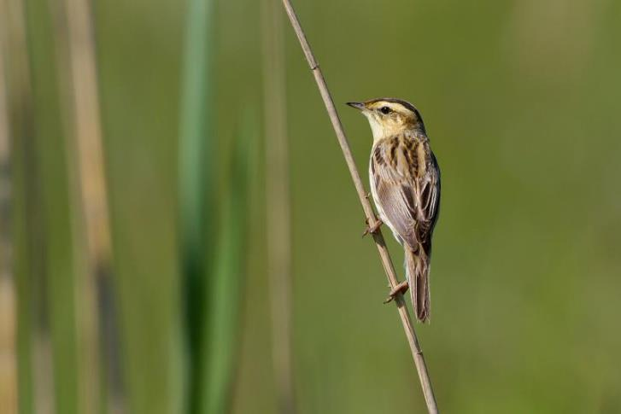
Brief history of Aquatic Warblers
used to be common in fen mires across Europe
vanished after agricultural intensification and drainage
tiny remnant population in western Poland
very peculiar breeding system: polygynandrous with no territories or site fidelity

Slide 3
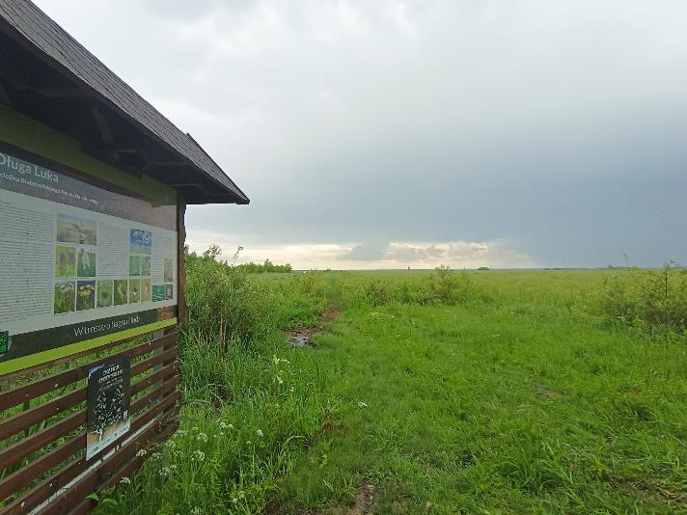
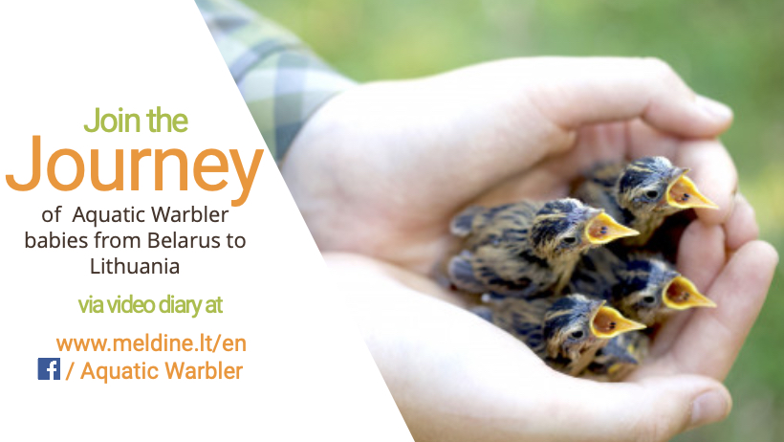
Goal of the project
prevent the extinction of the western sub-population through re-inforcement
re-introduction in Germany
re-inforcement in Lithuania
key questions:
how many birds need to be released / how many years?
how much habitat is required?

Slide 4
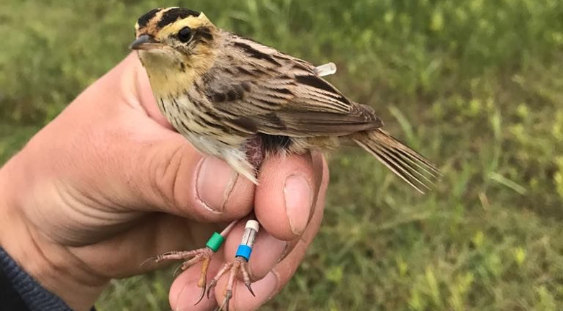
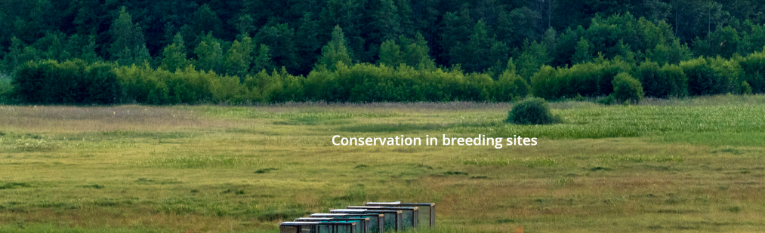
Analytical challenges
very few data – some counts and some juvenile releases (to estimate survival)
no adult survival data, productivity data, or densities from the target population
no information on movements and site fidelity
lots of scenarios: releases for 5-15 years, habitat from 200 – 2400 ha, survival +/-, management
formulating a question that can be answered with available data
Notes:
Original ask was to find out why the species went extinct and how many ha of habitat would be needed to secure a stable population

Slide 5
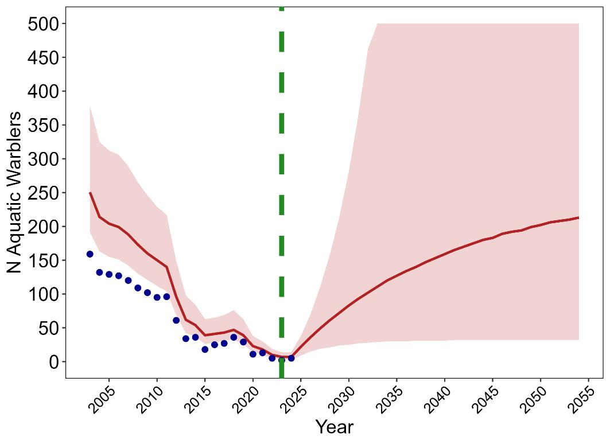
Results – overall population trajectory

Slide 6
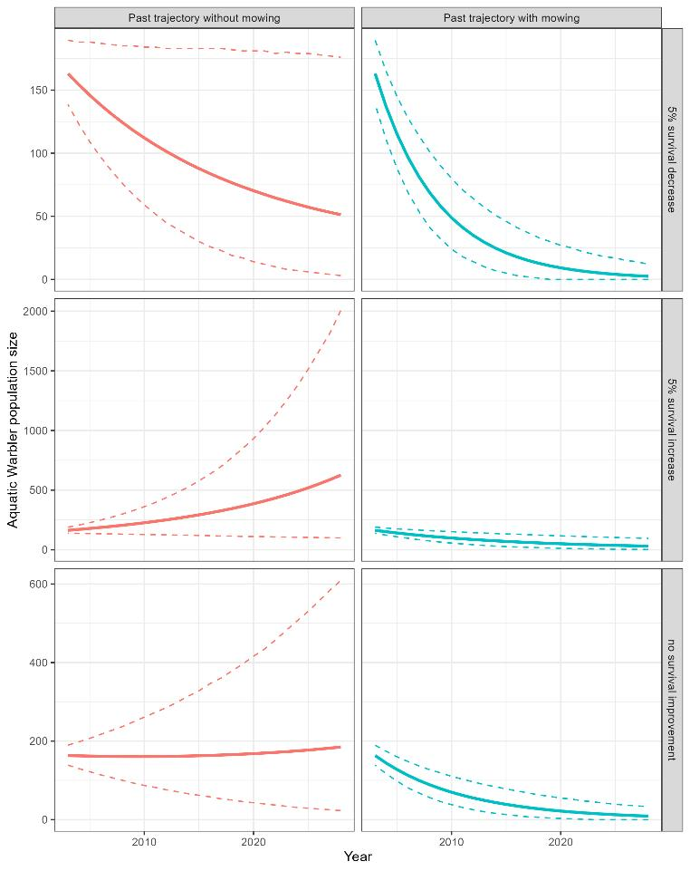
Results – hypothetical scenarios of the past

Slide 7
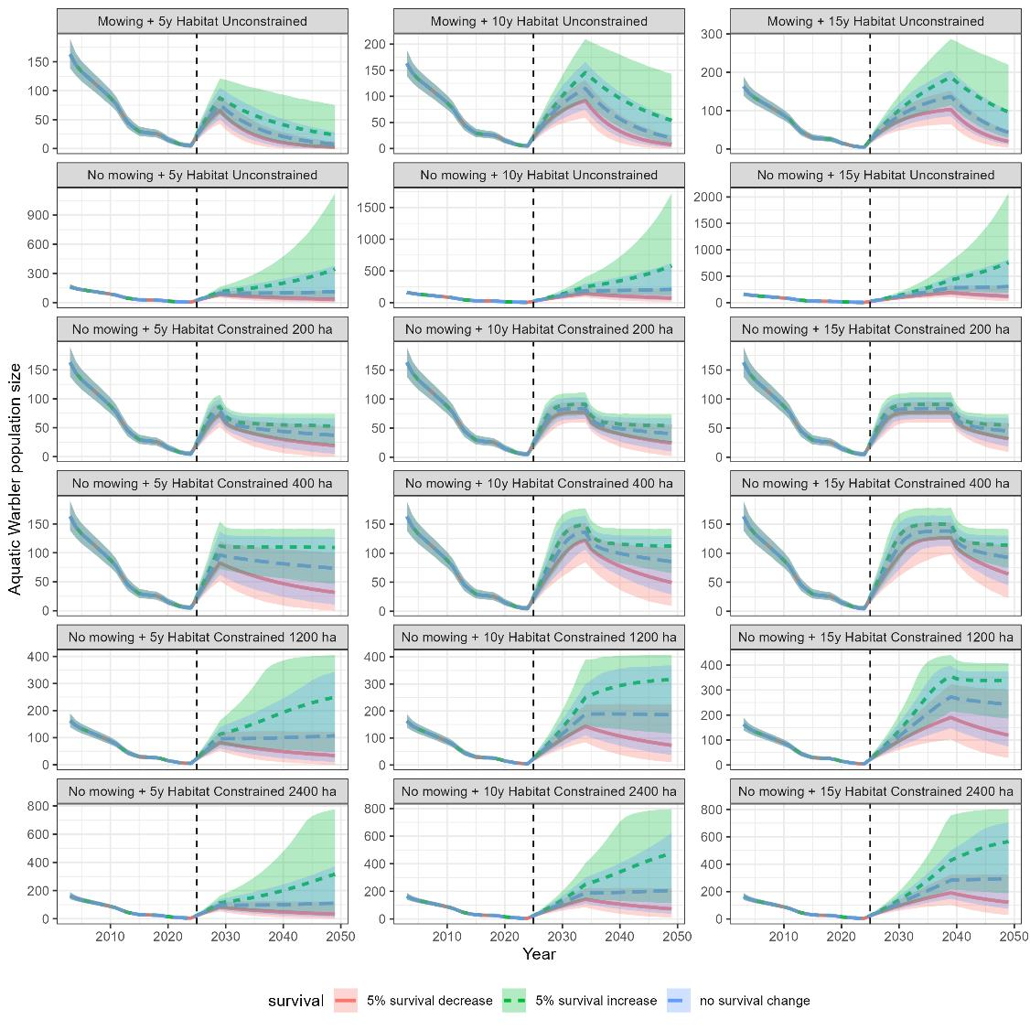
Results –
scenarios for the future

Slide 8
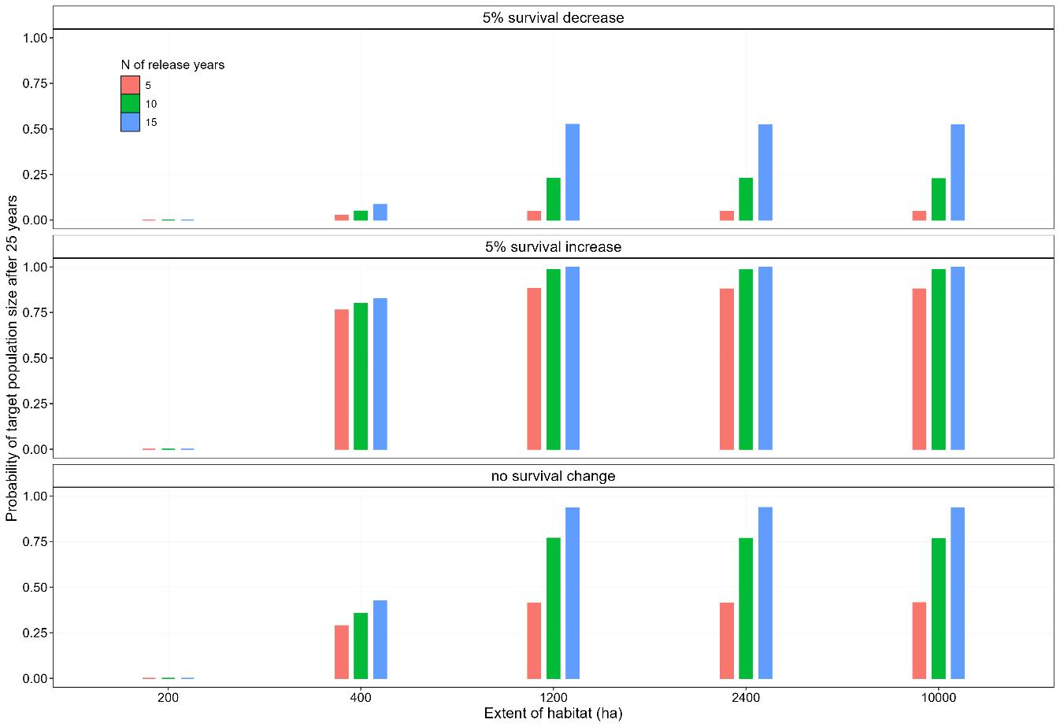
Results – probability to achieve target population size of 100 in 25 years

Slide 9
Main questions
How to build a population model with so few data? How to specify priors?
How to incorporate meta-population dynamics when there is no data?
What plausible/feasible scenarios can we simulate?

